Slide 1
Memory Management
CS422/522 Lecture 4
8 September 2014
Last updated: 8 September 2014
张义飞 2015

Slide 2
Outline
Recap / Pointers
Overview of Memory
Memory Models
Sharing Memory
Wrap-Up
张义飞 2015

Slide 3
Pointers
Basic Pointers:
int *x, y = 5, z = 7;
x = &y; // x points to y
*x = 6; // y now equals 6
x = &z; // x points to the z
z = 3; // y = 6, z = 3, *x = 3
张义飞 2015

Slide 4
Pointers
Incrementing a pointer:
8534 ph = (struct proghdr*)((uchar*)elf + elf−>phoff);
8535 eph = ph + elf−>phnum;
8536 for(; ph < eph; ph++){
8537 pa = (uchar*)ph−>paddr;
8538 readseg(pa, ph−>filesz, ph−>off);
8539 if(ph−>memsz > ph−>filesz)
8540 stosb(pa + ph−>filesz, 0,
ph−>memsz − ph−>filesz);
8541 }
张义飞 2015

Slide 5
Pointers Function pointer:
8545 entry = (void(*)(void))(elf−>entry);
8546 entry();
张义飞 2015

Slide 6
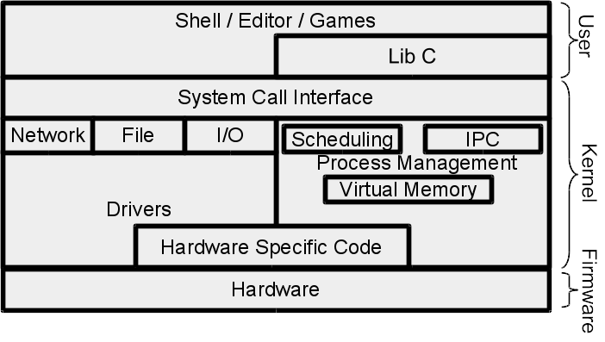
The Kernel
Lab 1 focuses on bootstrap and some hardware specific code
OS is layers of abstraction
张义飞 2015

Slide 7
Outline
Recap / Pointers
Overview of Memory
Memory Models
Sharing Memory
Wrap-Up
张义飞 2015

Slide 8
Introduction to Processes
Executing application or program that (believes it) has full domain of an abstracted system.
In this lecture: Use memory to provide a portion of this abstraction -- complete or near complete ownership of address space.
张义飞 2015

Slide 9
Memory Challenges
Address bus > processor word size
Protection / Isolation
Fragmentation
Sharing
张义飞 2015

Slide 10
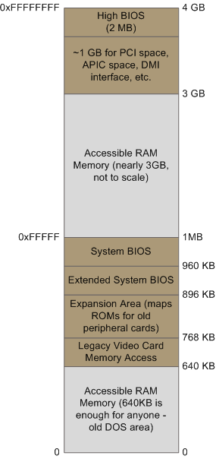
x86 Memory Layout
张义飞 2015

Slide 11
Virtual Memory
Hardware support for independent views of memory
Stored in physical RAM
Software only uses virtual memory addresses
OS maintains -- must be able to translate between the two
张义飞 2015

Slide 12
Outline
Recap / Pointers
Overview of Memory
Memory Models
Sharing Memory
Wrap-Up
张义飞 2015

Slide 13
x86 Memory Models
Real mode with segmentation
Protected mode with segmentation
Protected mode with paging
张义飞 2015

Slide 14
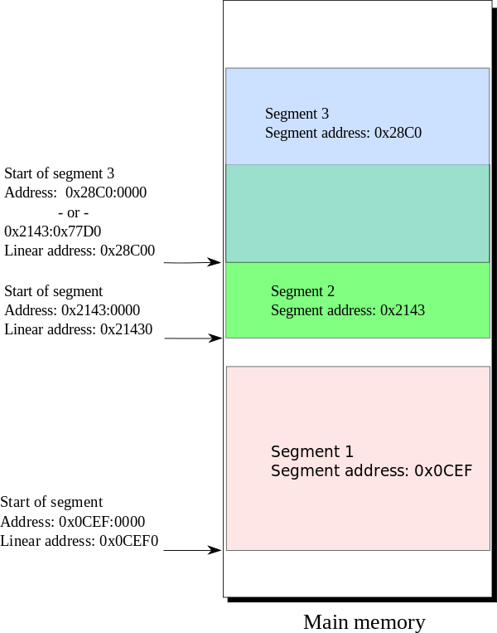
x86 Real Mode
8086 16-bit with 20-bit
address bus
Stored in segment registers:
CS, DS, ES, FS
Logical address - segment:offset
Physical address - (segment
* 0x10) + offset
张义飞 2015

Slide 15
Real Mode Segmentation
All except CS can be changed directly:
mv $0xf000, %ds
pop %ds
Changing the CS register:
jmp $0xf000, $0x10 # CS = $0xf000, EIP = $0xf0010
张义飞 2015

Slide 16
A 32-bit (64-bit) World
In a 32-bit world, where address bus = word size, what can this form of segmentation do for us?
Not too much, moving logical address 0 away from the holes near real address 0.
张义飞 2015

Slide 17
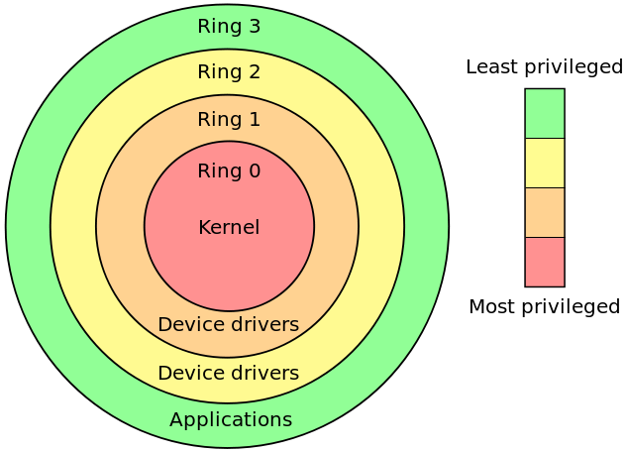
x86 Protected Mode
Memory isolation
Privileged instructions
CPL - Current Privielge Level
张义飞 2015

Slide 18
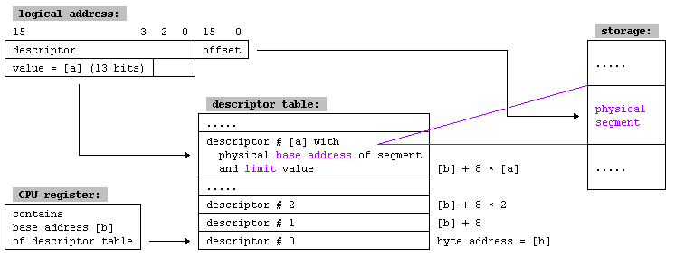
Protected Segmentation
Segmentation registers become indexes into a table:
        Global descriptor table
        Local descriptor table
        Operating system vs Program
张义飞 2015

Slide 19
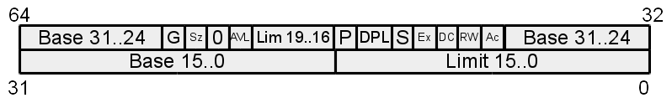
Descriptor Format
G - 1B / 4KB Blocks
Sz - 16 / 32 bit segment
AVL - Available for use
DPL - Descriptor Privilege Level
P - Present
S - System / Code or Data
Ex - Data / Code
RW - if Ex - R, if /Ex - W
Ac - Accessed
张义飞 2015

Slide 20
Enforcing Protection
Type checking
        P - Present
        S - System / Code or Data
        Ex - Data / Code
        RW - if Ex - R, if /Ex - W
张义飞 2015

Slide 21
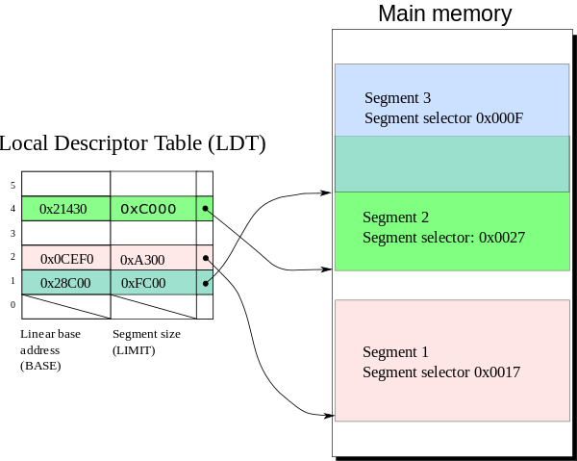
Enforcing Protection
Type checking
Limit checking
张义飞 2015

Slide 22
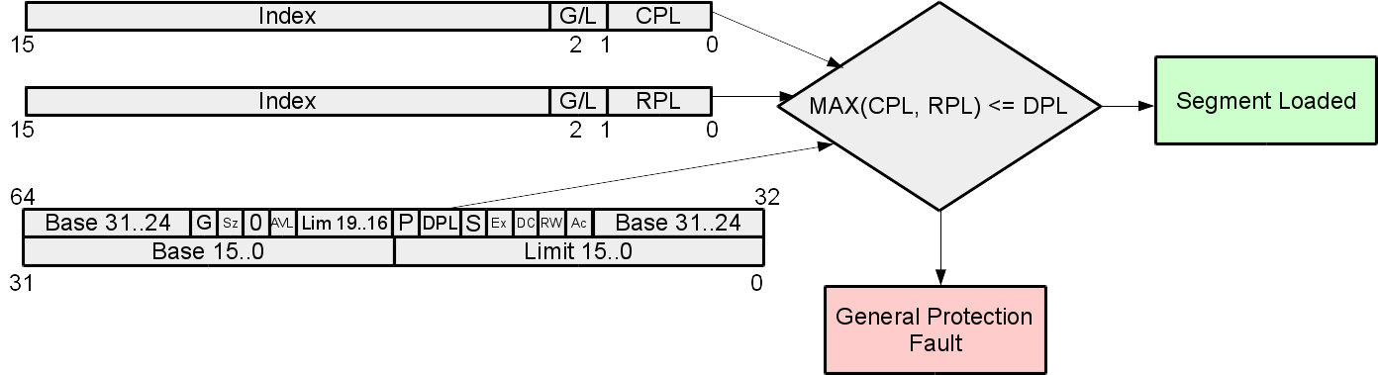
Enforcing Protection
Type checking
Limit checking
Privilege levels
张义飞 2015

Slide 23
Segmentation is great, right?
Must be physically backed
May be fragmented
Have to deal with memory holes
张义飞 2015

Slide 24
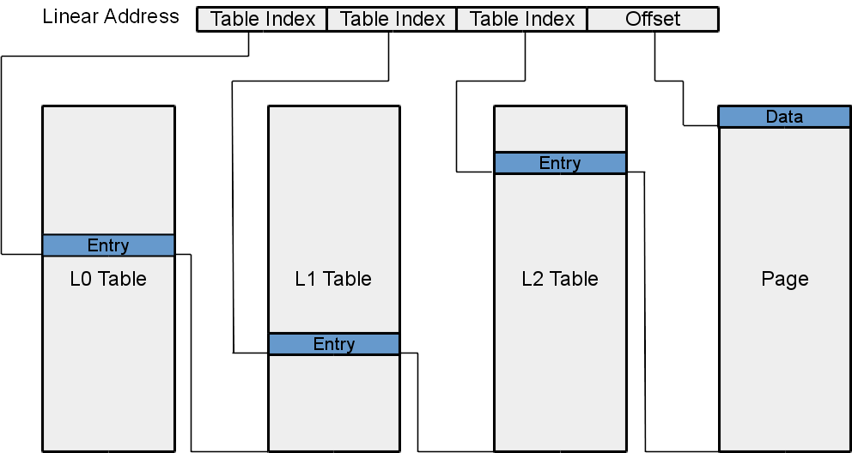
Paging
张义飞 2015

Slide 25
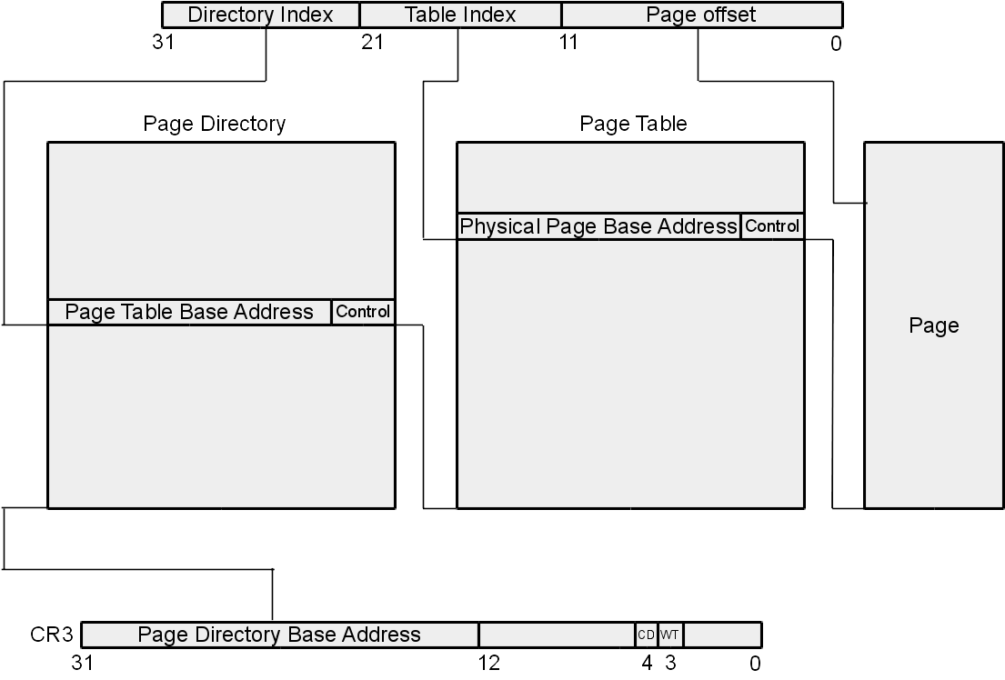
x86 Page Tables
张义飞 2015

Slide 26
x86 Page Table in Depth
10 bits directory offset
10 bits table index
12 bits page offset
PTE / PDE 4 bytes
Directory / Table - 1024 entries
Page - 4 KB
张义飞 2015

Slide 27
The Page Directory
CR3 - base address for directory.
Why more than one directory?
isolation / different views of memory
What type of control bits?
    S - 4KB / 4MB Page tables
    A - Accessed
    D - Disable cache
    W - Enable write-through caching
    U - Supervisor / User Page
    RW - Enable writing
    P - Present
张义飞 2015

Slide 28
The Page Table
Format:
    G - Global
    M - Modified
PDE is basically a PTE, x86 2 layer page table
张义飞 2015

Slide 29
The Page
Stored directly in memory
Everything is a page -- including page tables
How to access page tables? Requires a conversion from physical to virtual
张义飞 2015

Slide 30
4 MB Pages
What changes happen if we use 4 MB pages instead of 4 KB?
        No need to use page tables, merge PDE and PTE
        Performance
        More at www.rcollins.org/ddj/May96/
张义飞 2015

Slide 31
Memory Guarding with Page Tables
Consider a stack grows without bound
Eventually the stack runs out of space
Triggers general protection exception -- accessed unallocated memory
How to address in segmentation? Stack offers special handler, but other memory locations do not
Paging? Create a valid pte following allocated space, set present bit to 1
张义飞 2015

Slide 32
Segmentation and/or Paging
Are paging and segmentation compatible? yes
Features of segmentation?
  Course grained memory
  2 bits for privilege
  Cannot guard memory
Features of page tables?
  (Virtually) continuous memory
  Transparent
  (Nearly) Fixed size pages
  1 bit for privilege
  Memory guarding
张义飞 2015

Slide 33
Outline
Recap / Pointers
Overview of Memory
Memory Models
Sharing Memory
Wrap-Up
张义飞 2015

Slide 34
Sharing Memory
  Kernel shares certain data with processes
  Sharing of common code (libraries)
  Interprocess communication
Different ways of sharing?
  Like a pipe
  Different permissions
  Same / different locations in memory
张义飞 2015

Slide 35
Sharing a Segment
Libraries: common descriptor - same permissions, same base / limit
Pipes: different descriptor - set W = 1, same base / limit
OS data structures: different descriptor: set DPL 3/0, W=0/1, same base / limit
张义飞 2015

Slide 36
Sharing a Page
Libraries: common pde, common pte - same permissions, same physical page base address
Pipe: common pde, different pte - set W = 1, same physical page base address
OS data structures: (maybe) different pde, different pte - set U,W = (0,1), (1,0), may be mapped to different addresses
The final one cannot be done effectively in segmentation. Why?
张义飞 2015

Slide 37
Outline
Recap / Pointers
Overview of Memory
Memory Models
Sharing Memory
Wrap-Up
张义飞 2015

Slide 38
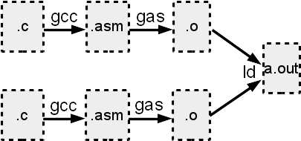
Compilation Process
Compiler, assembler, linking, loading
张义飞 2015

Slide 39
Lab 0 and Lab 1
Lab 0 - Shell, Due: 8/28 @ 11:59 PM
Lab 1 - Booting a PC, Due: 9/4 @ 11:59 PM
Waived late penalty until 9/10 @ 11:59 PM
Due: 9/4 @ 11:59 PM
张义飞 2015

Slide 40
Lab 2: Memory Management
Due: 9/11 @ 11:59 PM
Disabling segmentation
Page table management
Protecting the kernel
张义飞 2015

Slide 41
Systems Seminar
Tuesdays at 11:45AM
AKW307
Pizza
Please contact me if you intend to come
张义飞 2015

Slide 42
Next Time
Monday 1:00PM
Using Virtual Memory
张义飞 2015

